Slide 1
Contents
Non- Linear SVM
  Non- Linear SVM : Feature Space
  Transformation to Feature Space
SVM kernel functions
Applications

Slide 2
Non-Linear SVM
The idea is to gain linearly separation by mapping the data to a higher dimensional space.
Datasets that are linearly separable (with some noise) work out great
But what are we going to do if the dataset is just too hard?
How about … mapping data to a higher-dimensional space
0
x
x
x²
0
x

Slide 3
Non-Linear SVM : Feature Space
General idea: the original input space (x) can be mapped to some higher-dimensional feature space (φ(x) )where the training set is separable:
x=(x₁,x₂)
√2x₁x₂
Φ: x → φ(x)
x₂²
x₁²

Slide 4
Transformation to Feature Space
Possible problem of the transformation
  High computation burden due to high-dimensionality and hard to get a good estimate
SVM solves these two issues simultaneously
  “Kernel tricks” for efficient computation
  Minimize ||w||² can lead to a “good” classifier
φ( )
φ( )
φ( )
φ( )
φ( )
φ(.)
φ( )
φ( )
φ( )
φ( )
φ( )
φ( )
φ( )
φ( )
φ( )
φ( )
φ( )
φ( )
φ( )
Input space
Feature space
Key idea: transform x_{i} to a higher dimensional space

Slide 5
SVM Kernel Functions
SVM algorithms use a set of mathematical functions that are defined as the kernel. The function of kernel is to take data as input and transform it into the required form.
Different SVM algorithms use different types of kernel functions. These functions can be different types. For example linear, nonlinear, polynomial, radial basis function (RBF), and sigmoid.
The kernel functions return the inner product between two points in a suitable feature space. Thus by defining a notion of similarity, with little computational cost even in very high-dimensional spaces.

Slide 6
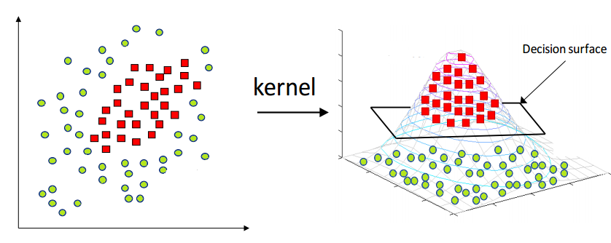
Support Vector Kernel

Slide 7
Support Vector Kernels
The linear classifier relies on an inner product between vectors
K(x_{i},x_{j})=x_{i}^{T}x_{j}
If every data point is mapped into high-dimensional space via some transformation Φ: x → φ(x), the inner product becomes:
K(x_{i},x_{j})= φ(x_{i}) ^{T}φ(x_{j})
A kernel function is some function that corresponds to an inner product in some expanded feature space.
Why use kernels?
  Make non-separable problem separable.
  Map data into better representational space

Slide 8
Kernel Functions
.
Linear Kernel: K(X,Y)=X^{T}Y + c
Polynomial kernel: K(X,Y)=(γ⋅X^{T}Y+r)^{d},γ>0
Radial basis function (RBF) Kernel: K(X,Y)=exp(∥X−Y∥²/2σ²) which in simple form can be written as exp(−γ⋅∥X−Y∥²),γ>0

Slide 9
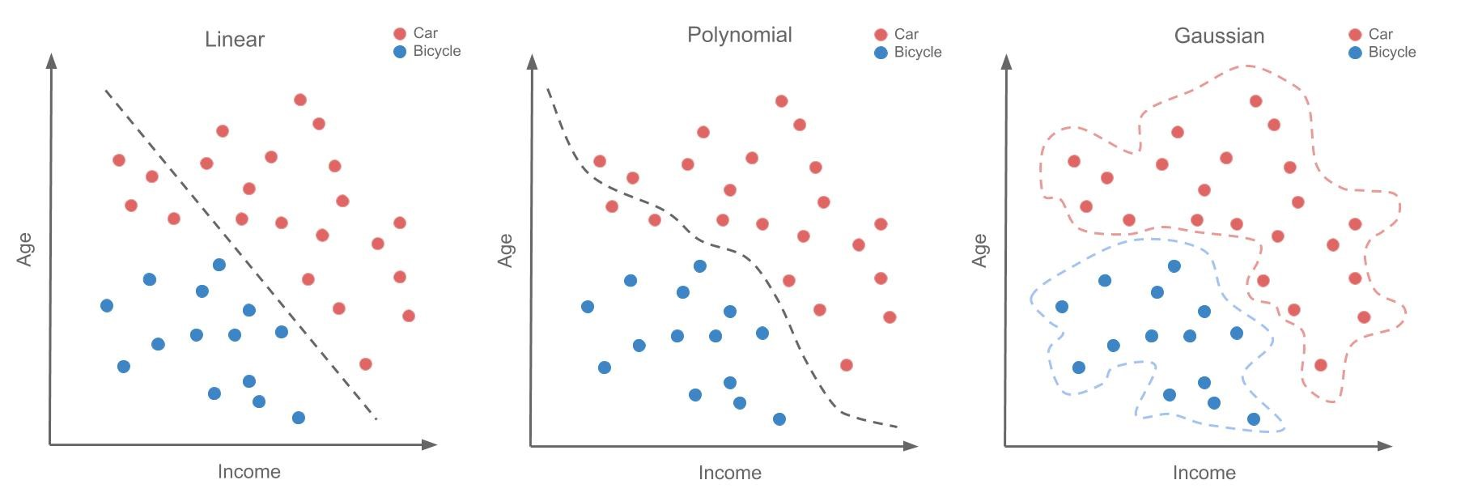
Data representation using kernels

Slide 10
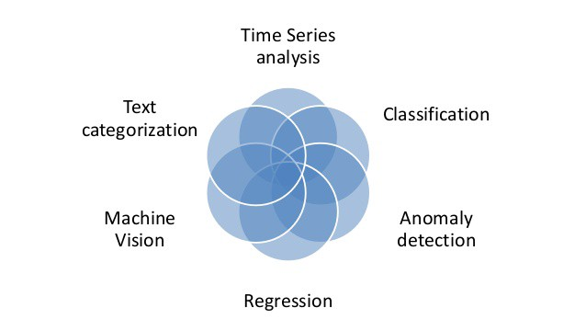
Applications

Slide 11
Thank
You

